Slide 1
Computer - Vision
Lecture: 05
Fourier Transform, Convolution and Filtering
By Anshika Malsaria

Slide 2
Image Transformation:
An image is obtained in spatial coordinates (x, y) or (x, y, z). There are many advantages if the spatial domain image is transformed into another domain. In which solution of any problem can be found easily.
Fourier Transform
Fourier transform is mainly used for image processing. In the Fourier transform, the intensity of the image is transformed into frequency variation and then to the frequency domain. It is used for slow varying intensity images such as the background of a passport size photo can be represented as low-frequency components and the edges can be represented as high-frequency components. Low-frequency components can be removed using filters of FT domain. When an image is filtered in the FT domain, it contains only the edges of the image. And if we do inverse FT domain to spatial domain then also an image contains only edges. Fourier transform is the simplest technique in which edges of the image can be fined.

Slide 3
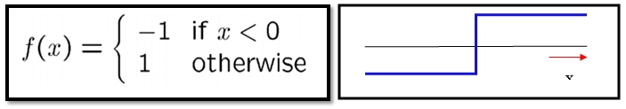
Fourier series is a state in which periodic signals are represented by summing up sines and cosines and multiplied with a certain weight. The periodic signals are further broken down into more signals with some properties which are listed below:
Broken signals are sines and cosines.
New signals are harmonics of each other.
Fourier series analysis of a step edge:

Slide 4
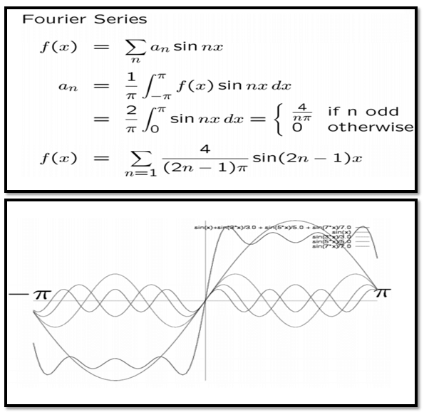
Fourier decomposition

Slide 5
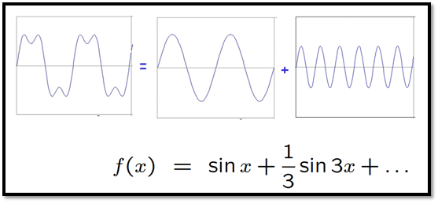
Example:

Slide 6
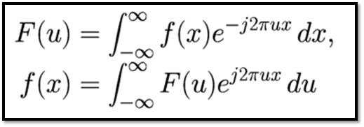
Fourier Transformation
Fourier transformation is a tool for image processing. it is used for decomposing an image into sine and cosine components. The input image is a spatial domain and the output is represented in the Fourier or frequency domain. Fourier transformation is used in a wide range of application such as image filtering, image compression. Image analysis and image reconstruction etc.
The formula for Fourier transformation:

Slide 7
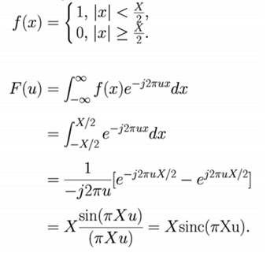
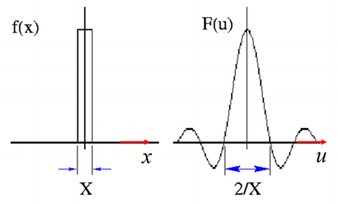
Example:

Slide 8
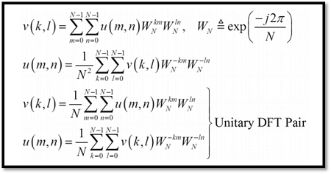
Two Dimensional Fourier Transform

Slide 9
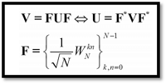
Matrix Notation:
Properties of Fourier transformation are as follows:
Symmetric Unitary
Periodic Extension
Sampled Fourier
Fast
Conjugate Symmetry
Circular Convolution

Slide 10
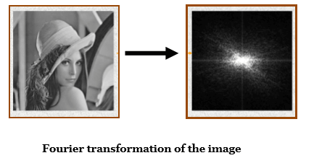
Example:

Slide 11
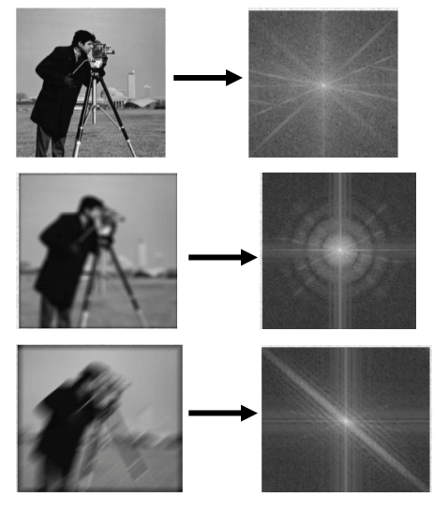
Example of Blurred image and its Fourier transformation

Slide 12
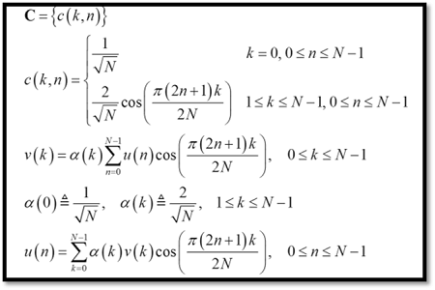
Discrete Cosine Transformation (DCT):
In Discrete Cosine Transformation, coefficients carry information about the pixels of the image. Also, much information is contained using very few coefficients, and the remaining coefficient contains minimal information. These coefficients can be removed without losing information. By doing this, the file size is reduced in the DCT domain. DCT is used for lossy compression.
One Dimension Discrete cosine transformation:

Slide 13

Two Dimension Discrete cosine transformations:
Properties of Discrete cosine transformation are as following:
Real and Orthogonal: C=C* → C-1=CT
Not! Real part of DFT
Fast Transform
Excellent Energy Compaction (Highly Correlated Data)

Slide 14
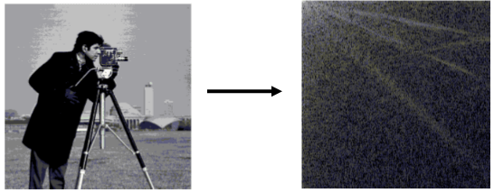
Example:
Applications of image transforms are as follows:
Fourier transform is used for Edge Detection.
Discrete Cosine Transform is used for image compression.

Slide 15
Gray Level Transformation
All Image Processing Techniques focused on gray level transformation as it operates directly on pixels. The gray level image involves 256 levels of gray and in a histogram, horizontal axis spans from 0 to 255, and the vertical axis depends on the number of pixels in the image.
The simplest formula for image enhancement technique is:
s = T * r
Where T is transformation, r is the value of pixels, s is pixel value before and after processing.

Slide 16
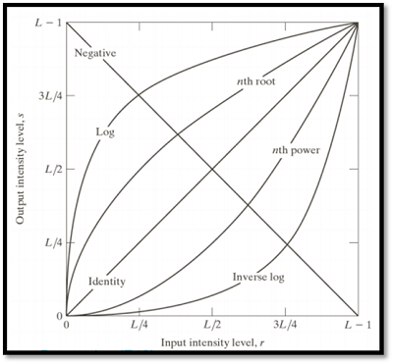
Let,
r = f(x,y)
s = g(x,y)
'r' and 's' are used to denote gray levels of f and g at(x,y)
There are three types of transformation:
Linear
Logarithmic
Power - law
The overall graph is shown below:
Gray Level Transformation

Slide 17
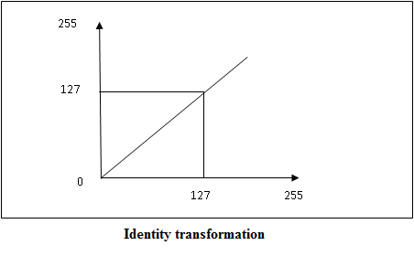
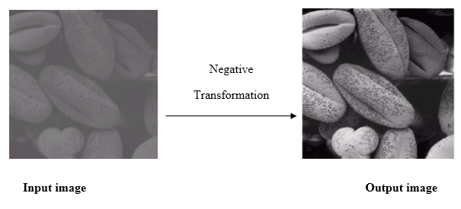
Linear Transformation
The linear transformation includes identity transformation and negative transformation.
In identity transformation, each value of the image is directly mapped to each other values of the output image.
Negative transformation is the opposite of identity transformation. Here, each value of the input image is subtracted from L-1 and then it is mapped onto the output image.

Slide 18
Logarithmic transformations
Logarithmic transformation is divided into two types:
Log transformation
Inverse log transformation
The formula for Logarithmic transformation
s = c log(r + 1)
Here, s and r are the pixel values for input and output image. And c is constant. In the formula, we can see that 1 is added to each pixel value this is because if pixel intensity is zero in the image then log(0) is infinity so, to have minimum value one is added.
When log transformation is done dark pixels are expanded as compared to higher pixel values. In log transformation higher pixels are compresses.

Slide 19
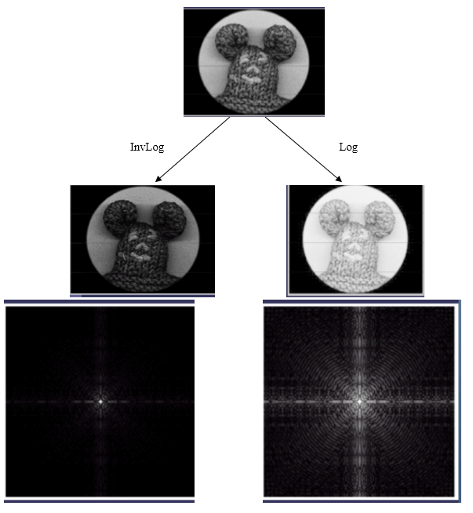
In the above image (a) Fourier Spectrum and (b) result of applying Log Transformation.

Slide 20
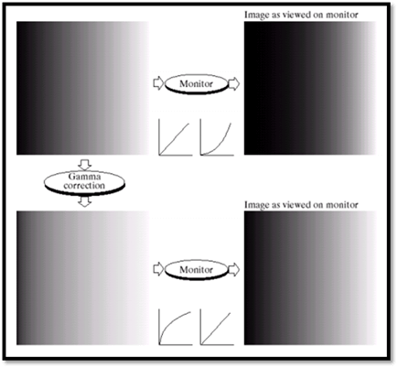
Power - Law transformations
Power Law Transformation is of two types of transformation nth power transformation and nth root transformation.
Formula:
s = cr ^ γ
Here, γ is gamma, by which this transformation is known as gamma transformation.
All display devices have their own gamma correction. That is why images are displayed at different intensity.
These transformations are used for enhancing images.
For example:
Gamma of CRT is between 1.8 to 2.5

Slide 21
Image Enhancement
The main objective of Image Enhancement is to process the given image into a more suitable form for a specific application. It makes an image more noticeable by enhancing the features such as edges, boundaries, or contrast. While enhancement, data does not increase, but the dynamic range is increased of the chosen features by which it can be detected easily.
In image enhancement, the difficulty arises to quantify the criterion for enhancement for which enhancement techniques are required to obtain satisfying results.
There are two types of Image enhancement methods:
Spatial domain technique
Frequency domain technique

Slide 22
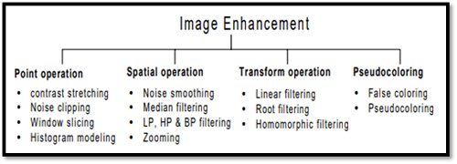

Slide 23
Spatial domain enhancement methods
Spatial domain techniques are performed on the image plane, and they directly manipulate the pixel of the image.
Operations are formulated as:
g(x,y) = T[f(x, y)]
Where g is the output image, f is the input image, and T is operation
Spatial domain techniques are further divided into 2 categories:
Point operations (linear operation)
Spatial operations (non-linear operation)
Frequency domain enhancement methods
Frequency domains enhance an image by following complex linear operators.
G(w1, w2) = F(w1, w2) H(w1, w2)
Image enhancement can also be done through Gray Level Transformation.

Slide 24
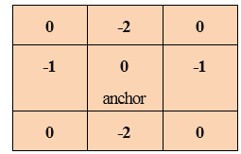
Concept of Convolution
Convolution is used for many things like calculating derivatives, detect edges, apply blurs etc. and all this is done using a "convolution kernel". A convolution kernel is a very small matrix and in this matrix, each cell has a number and also an anchor point.
The anchor point is used to know the position of the kernel with respect to the image. It starts at the top left corner of the image and moves on each pixel sequentially. Kernel overlaps few pixels at each position on the image. Each pixel which is overlapped is multiplied and then added. And the sum is set as the value of the current position.

Slide 25
Convolution is the process in which each element of the image is added to its local neighbors, and then it is weighted by the kernel. It is related to a form of mathematical convolution.
In Convolution, the matrix does not perform traditional matrix multiplication but it is denoted by *.
Suppose, there are two 3x3 matrices, one is kernel and another one is an image piece. In convolution, rows and columns of the kernel are flipped and then they are multiplied and then summing is performed. Elements which are present in the centre of matrix i.e. in [2,2] of the image will be weighted combination of the image matrix and the weights will be given by the kernel. Similarly, all the other elements of the matrix will be weighted and then weights will be computed.

Slide 26
Following is pseudo code to describe the convolution process:
For each image row in input image:
For each pixel in image row:
Set accumulator to zero
For each kernel row in kernel:
For each element in kernel row:
If element position corresponding* to pixel position then
Multiply element value corresponding*to pixelvalue
Add result to accumulator
Endif
Set output image pixel to accumulator

Slide 27
Convolution can be computed using multiple for loops. But using for loops causes a lot of repeated calculation and also the size of image and kernel increases. Using Discrete Fourier Transform technique calculating convolution can be done rapidly. In this technique, the entire convolution operation is converted into a simple multiplication.
In convolution, the problem occurs when the kernel is near the edge or corners because the kernel is two dimensional.
To overcome these problems following things can be done:
Ones can be ignored
Extra pixels can be created near the edges.
Extra pixels can be created in the following ways:
Duplicate edge pixel.
Reflect edges
Pixels can be copied from the other end.

Slide 28
Concept of Mask
The concept of a mask is also known as spatial filtering. Mask is a type of filter which performs operation directly on the image. The filter mask is also known as convolution mask.
To apply a mask on an image, filter mask is moved point to point on the image. In the original image, at each point(X, Y), filter is calculated by using a predefined relationship.
There are two types of filters:
Linear filter
Frequency domain filter

Slide 29


Linear filter
A linear filter is the simplest filter. In linear filter, each pixel is replaced by the average of these pixel values. The entire linear filter works in the same way except when the weighted average is formed instead of a simple average.
The formula for a linear filter
Example:

Slide 30
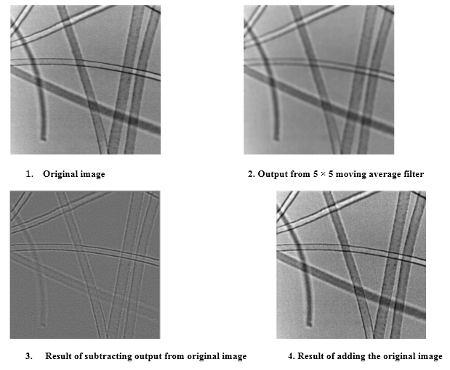

Slide 31
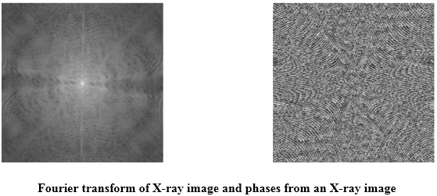
Frequency Domain Filter
In frequency domain filter, an image is represented as the sum of many sine waves which have different frequencies, amplitudes and directions. The parameter of sine waves is referred to as Fourier coefficients.
Reasons for using this approach:
For getting extra insight.
Linear filters can also in the frequency domain use Fast Fourier Transform (FFT)

Slide 32
Filters are used for 2 purposes:
Blurring and noise reduction.
Edge detection and sharpness.
Blurring and noise reduction
Filters can be used for blurring as well as noise reduction from an image. Blurring is used to remove small details from an image. Noise reduction can also be done with the help of blurring.
Commonly used masks for blurring are:
Box filter
Weighted average filter
Edge Detection and sharpness
Filters can be used for edge detection and sharpness. To increase the sharpness of an image, edge detection is used.

Slide 33
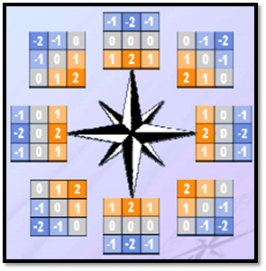
Robinson compass mask
A Robinson compass mask is a type of mask which is used for edge detection. It has eight orientations. It is also known as the direction mask. It extracts the edges with respect to its direction. Following are its eight orientations:
North
North West
West
South West
South
South East
East
North East
It does not have any fixed mask. We have to rotate the mask to find an edge in any one direction above mention. Masks are rotated from zero columns on the basis of direction.

Slide 34
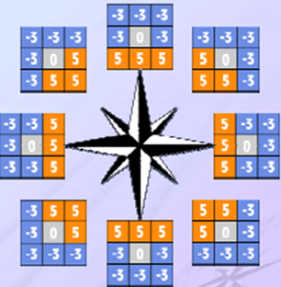
Krisch Compass Mask
Kirsch compass mask is used for finding edges. It is almost the same as Robinson compass mask. It also has 8 direction compass. The main difference between Robinson and kirsch compass masks is that in kirsch we can change the mask according to the requirements.
Following are its eight orientations:
North
North West
West
South West
South
South East
East
North East
Standard size is taken and then it is rotated in all directions.

Slide 35
Concept of Blurring
In Digital image processing, blurring is used to make an image smooth in which edges are not observed. Suppose, we have an image in which there are 508*340=172,720 pixels. If we want to blur this image, then all the 172,720-pixel values will be changed by using the blurring technique and convolution as we know that in an image, there are 8 pixels around it. When these pixels are combined as 8+1=9, a 3x3 matrix is formed. In our image, there are 172,720 pixels, so there will be 172,720 matrices of 3x3 orders. By applying convolution in all 172,720 matrices with a common matrix called the kernel. The kernel is a special matrix, it changes the pixels using convolution to make an image blur. A low pass filter is used for blurring as it allows the low frequency to allow and stop the high frequency. The term frequency means to change the value of the pixel.

Slide 36


Blurring vs. Zooming
When an image is blurred, and it is zoomed, the zooming factor is increased. This is because when we zoom an image, many new pixels are added and when an image is blurred the pixels of the normal image and blurred image remains the same.
Original image
Blurred image

Slide 37
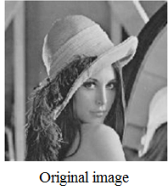
High Pass vs Low Pass Filters
Lowpass filter (smoothing)
A low pass filter is used to pass low-frequency signals. The strength of the signal is reduced and frequencies which are passed is higher than the cut-off frequency. The amount of strength reduced for each frequency depends on the design of the filter. Smoothing is low pass operation in the frequency domain.
Following are some lowpass filters:

Slide 38


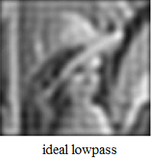
1. Ideal Lowpass Filters
The ideal lowpass filter is used to cut off all the high-frequency components of Fourier transformation.
Below is the transfer function of an ideal lowpass filter.

Slide 39

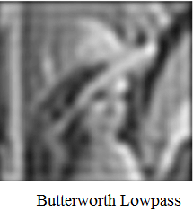
2. Butterworth Lowpass Filters
Butterworth Lowpass Filter is used to remove high-frequency noise with very minimal loss of signal components.

Slide 40

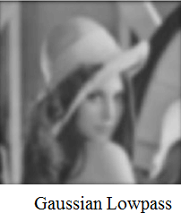
3. Gaussian Lowpass Filters
The transfer function of Gaussian Lowpass filters is shown below:

Slide 41
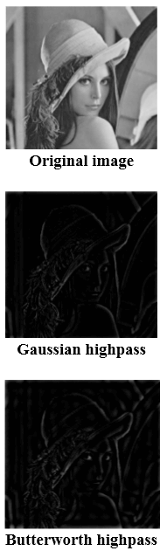
Highpass filters (sharpening)
A highpass filter is used for passing high frequencies but the strength of the frequency is lower as compared to cut off frequency.
Sharpening is a highpass operation in the frequency domain. As lowpass filter, it also has standard forms such as Ideal highpass filter, Butterworth highpass filter, Gaussian highpass filter.

Slide 42
Thanks…..

